Slide 1

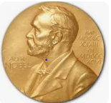
NOBEL PRIZE ANALYSIS
FOR DATALEUM HACKATHON
4.0 EDITION.
PRESENTED BY:
ODUMERU ADEOLA JULIET
HARUNA KWARI
SEPTEMBER 21, 2024

Slide 2
CONTENTS
01
INTRODUCTION TO THE STATEMENT
02
NOBEL PRIZE ANALYSIS
03
INSIGHTS
04
CONCLUSION

Slide 3


OVERVIEW
NOBEL PRIZE STATEMENT
In September every year, people who fulfil the criteria set out by the prize awarding institutions are allowed to nominate candidate for the Nobel prize.
Hundreds or Thousands of Nomination are received every year from member of Academies, University Professors, Scientist, Previous Noble Prize Laureates, member of parliamentary assemblies and more.
According to the terms of Swedish chemist, engineer, and industrialist Alfred Nobel's 1895 will, which was made the year before his death, the Nobel Prize is given in five different categories to the person or people who have contributed the most to humanity in the year that has passed. First prizes were given out by the Nobel Foundation in 1901. In his will, Nobel specified that the prizes be given out in the following areas: literature, peace, physiology or medicine, physics, and chemistry.

Slide 4
OVERVIEW
NOBEL PRIZE STATEMENT
It is also common to include the sixth prize for Economic Sciences, which is administered by the Nobel Foundation and was established by Sveriges Riksbank, the central bank of Sweden, and was first awarded in 1969.
The first Nobel Prizes were given out in 1901 after a protracted process to realize his vision started after his death. Alfred Nobel's legacy lives on with the Sveriges Riksbank Prize in Economic Sciences, which was instituted in 1969. To commemorate the tercentennial of Sweden's central bank, its addition was an exception. New Nobel Prize winners and laureates are announced annually in October.

Slide 5
OVERVIEW
NOBEL PRIZE STATEMENT
As a Data Analyst the task is to conduct a comprehensive analysis and visualization on Nobel Prize, the number of record for the analysis is 923, while other variable to be consider and six categories' Physics, Chemistry, Peace , Medicine, Literature and Economic awarded by Prominent Female and Male which has contribute tremendously to humankind in solving problem and providing a solution. The year recorded for 1901 -2021 for the datasets.
In this report, we aim to reveal interesting trends and patterns in the history of the Nobel Prizes, such as the distribution of prizes by nation, gender, and category, the most frequently awarded laureates and their contributions, and the influence of global events on the Nobel Prizes.
Our analysis of the Nobel Prizes data allowed me to offer insightful analysis of the most important prizes in physics, chemistry, medicine, literature, peace, and economics.

Slide 6
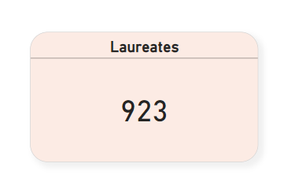
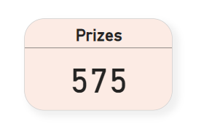
OVERVIEW
NOBEL PRIZE ANALYSIS
This shows the total record for Laureate that was awarded from 1901 to 2021
This shows the total record for Prize that was awarded to the Laureate

Slide 7
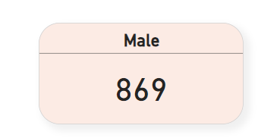
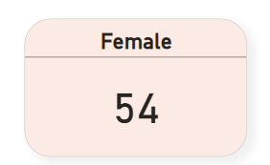
OVERVIEW
NOBEL PRIZE ANALYSIS
This shows the total record for Male Laureate that will be awarded for the Nobel prize.
This shows the total record for female Laureate that will be awarded for the Nobel prize.

Slide 8
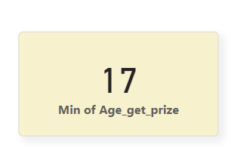
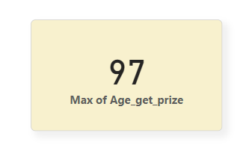
OVERVIEW
NOBEL PRIZE ANALYSIS
This shows the minimum average of youngest laureate awardee
This shows the maximum average of oldest laureate awardee

Slide 9
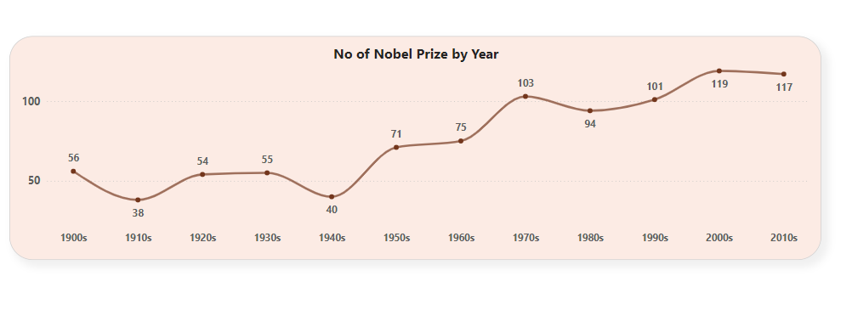
OVERVIEW
NOBEL PRIZE REPORT
This shows trend of No of Nobel prize over the years from 1901 to 2021
The Year 2021 has the highest number awardee between male and female.

Slide 10
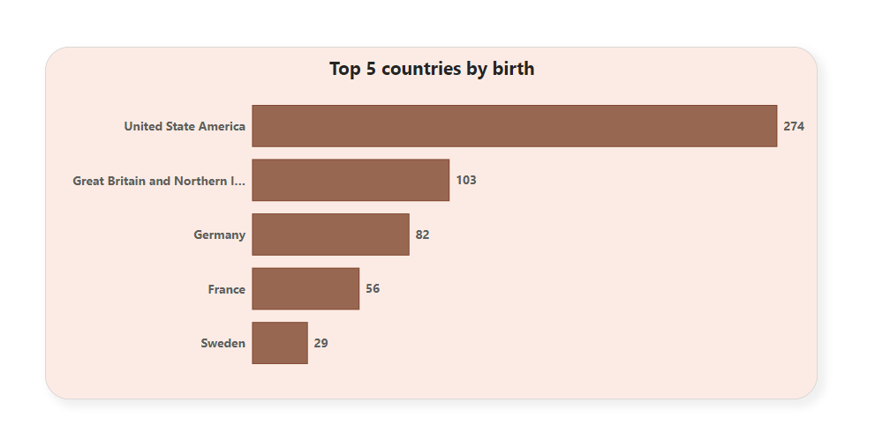
OVERVIEW
NOBEL PRIZE REPORT
This Bar Chart show the number of Laureate awardee by Top 5 Countries by Birth.
United State of America has the highest number of Laureate.

Slide 11
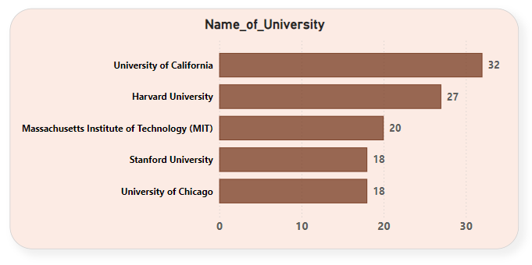
OVERVIEW
NOBEL PRIZE REPORT
This Bar Chart shows the Top 5 University by number of Laureates awarded.
University of California has the highest number of Laureates.

Slide 12
OVERVIEW
CONCLUSION
The Nobel Prize embodies the spirit of human ingenuity celebrating visionaries who shape our world, As reflect on the achievement of Nobel Laureates, we are reminded of the power of innovation, compassion, and dedication to create a brighter future for all.
The Nobel Prize impact and legacy must be preserved by
Promoting peace and conflict resolution.
Encouraging innovative research and discovery.
Fostering global cooperation and collaboration.
Inspiring future generation of leaders and change-makers.
Recognizing human achievement , driving progress and excellence.

Slide 13
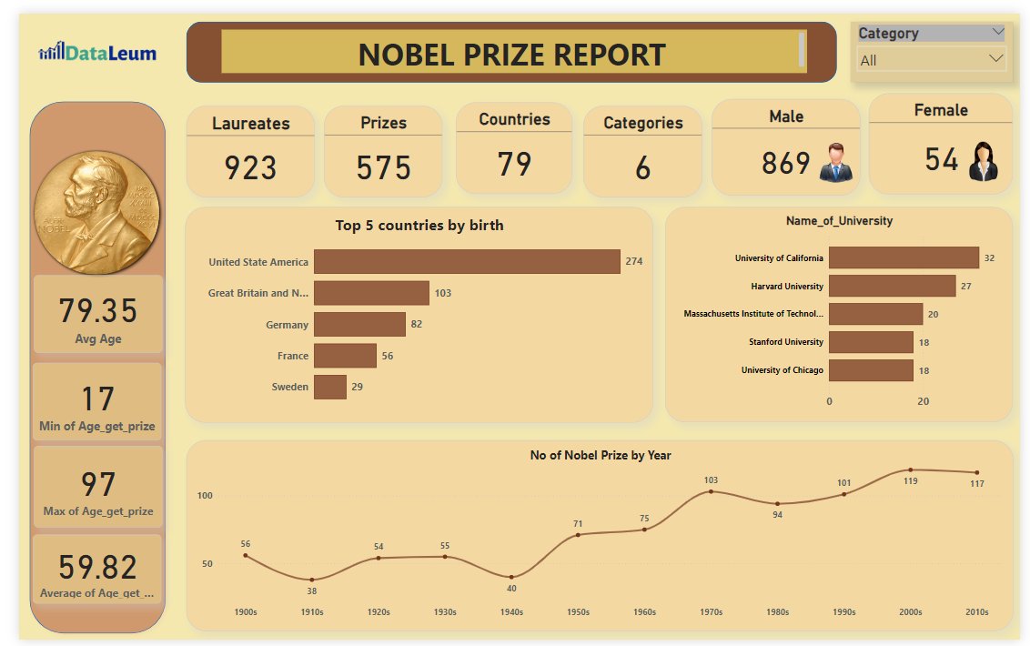
OVERVIEW
SUMMARY

Slide 14
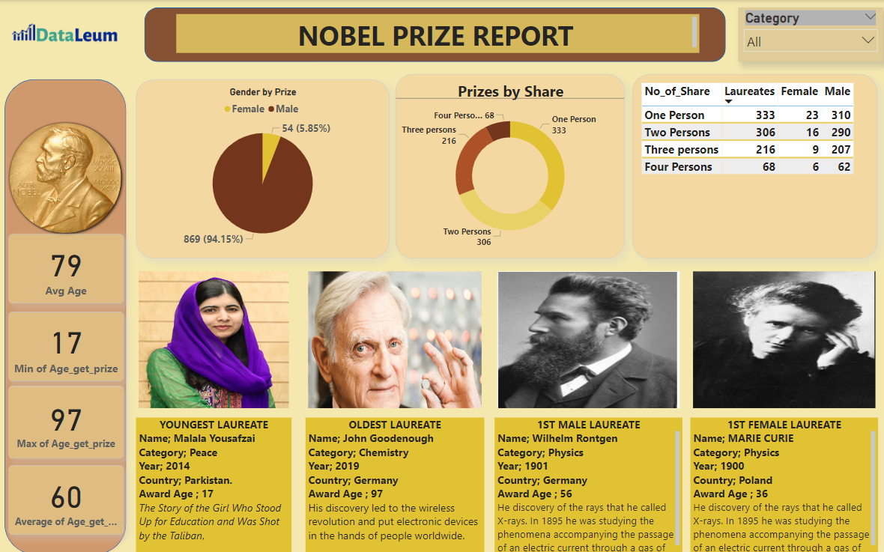
OVERVIEW
SUMMARY

Slide 15

THANK
YOU

